Slide 1
The business outcomes
Analyze how much time is spent per ride
Based on date and time factors such as day of week and time of day
Based on which station is the starting and / or ending station
Based on age of the rider at time of the ride
Based on whether the rider is a member or a casual rider
Analyze how much money is spent
Per month, quarter, year
Per member, based on the age of the rider at account start
EXTRA CREDIT - Analyze how much money is spent per member
Based on how many rides the rider averages per month
Based on how many minutes the rider spends on a bike per month

Slide 2
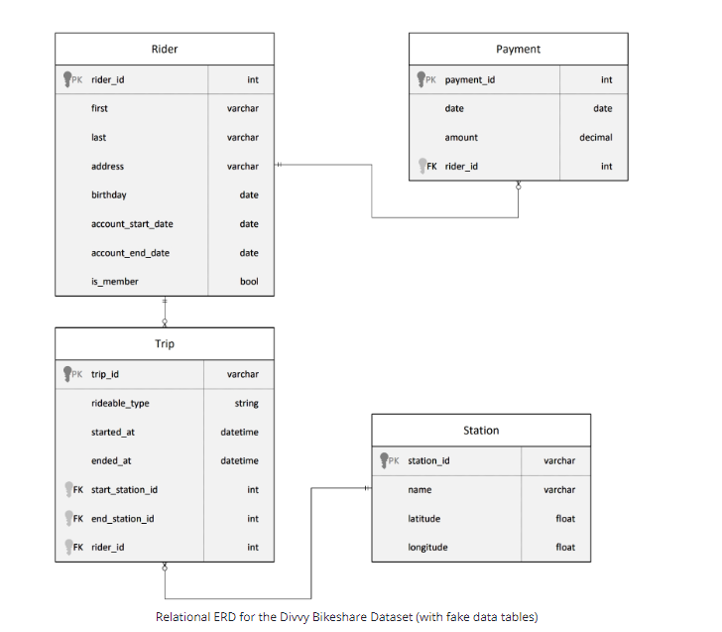

Slide 3
Star schema based on the relational diagram and the business problems
Rider_dimension
riderid | integer
birthday | Date
Member_flag | bit
startdate | Date
AccountStartAge | integer
Payment_fact
payment_id | string
date | date
amount | integer
account_number | integer
Calendar_dimension
Date | date
Weekday | integer
Year | integer
Month | integer
Quarter | integer
Trip_fact
trip_id | string
start_at | timestamp
end_at | timestamp
start_station_id | string
TimeDay, | string
member_id | integer
Druation | integer
Age_at_Time_of _Trip | integer
Station_dimension
stationid | string
name | string

Slide 4
Analyze how much time is spent per ride
Based on date and time factors such as day of week and time of day
Based on which station is the starting and / or ending station
Based on age of the rider at time of the ride
Based on whether the rider is a member or a casual rider
Rider_dimension
riderid | integer
birthday | Date
Member_flag | bit
startdate | Date
AccountStartAge | integer
Calendar_dimension
Date | date
Weekday | integer
Year | integer
Month | integer
Quarter | integer
Trip_fact
trip_id | string
start_at | timestamp
end_at | timestamp
start_station_id | string
TimeDay, | string
member_id | integer
Druation | integer
Age_at_Time_of _Trip | integer
Station_dimension
stationid | string
name | string

Slide 5
Analyze how much money is spent
Per month, quarter, year
Per member, based on the age of the rider at account start
Rider_dimension
riderid | integer
birthday | Date
Member_flag | bit
startdate | Date
AccountStartAge | integer
Payment_fact
payment_id | string
date | date
amount | integer
account_number | integer
Calendar_dimension
Date | date
Weekday | integer
Year | integer
Month | integer
Quarter | integer

Slide 6
EXTRA CREDIT - Analyze how much money is spent per member
Based on how many rides the rider averages per month
Based on how many minutes the rider spends on a bike per month
Calendar_dimension
Date | date
Weekday | integer
Year | integer
Month | integer
Quarter | integer
Trip_fact
trip_id | string
start_at | timestamp
end_at | timestamp
start_station_id | string
TimeDay, | string
member_id | integer
Druation | integer
Age_at_Time_of _Trip | integer
Payment_fact
payment_id | string
date | date
amount | integer
account_number | integer
member_behavior
member_id
CountTripPerMonth
SpentTimePerMonth

